Slide 1
Rightsizing your Terraform Modules
Rene Schach – 03.06.2025
HashiDays London

Slide 2

Introduction
Rene schach
Senior Cloud Consultant
Google Cloud
Kubernetes
IaC
Notes:
Explain scenario:
When using IaC/Terraform in a company, developing internal modules for specific scenarions is more than useful (e.g. Kubernetes Clusters, VPCs, Virtual machines)
Public module are nice, but in general way too big because they want to support each and every feature (even alpha or beta ones) and are not scoped to internal requirements
Internal modules are scoped to best fit your companies requirements
However, when developing good internal terraform modules you need to consider a set of areas and different aspects

Slide 3
What does „Rightsizing“ mean ?
Notes:
Explanation:
It’s not only about the actual size of the module
”synonym” for Best Practices
-> Forward to next slide

Slide 4




Rightsizing
Scope considerations
Code considerations
Security considerations
Module testing
How “big” should a module be ?
defining inputs/outputs, versioning
Input validation, defining level of configurability
Nobody likes it, but it’s essential
Notes:
Animationen nicht vergessen
End phrase: we’ll go into the details of every area in course of this presentation
Add note: of course this is subjective and my point of view, you can talk days about this topic. I tried to find and summaize the most crucial aspects in this 30 min presentation
If you have different opinions or you think that there are some aspects that are even more important, then this is totally fine and expected.
We can of course talk about this after this presentation

Slide 5

Module Scope
Listen to your module users/customers
Keep modules cohesive and loosely coupled
For reusable modules: separation of concerns
Recommendations:
Group resources that belong together
Split resources based on their volatility
Notes:
Can certainly be too big or too small
But it’s not a matter of a certain number of resources or can be exactly numbered (especially the “too big” side)
Customers: especially important for internal modules, as you can tightly couple them to company-internal use cases
Loosely coupled: one change in the tfvars or input of one module should not lead to resource changes in 20 different other modules
Group resources that should be deployed together
Example: GKE cluster -> service account for nodes and permission for service account
Separate long-lived from short-lived infrastructure

Slide 6
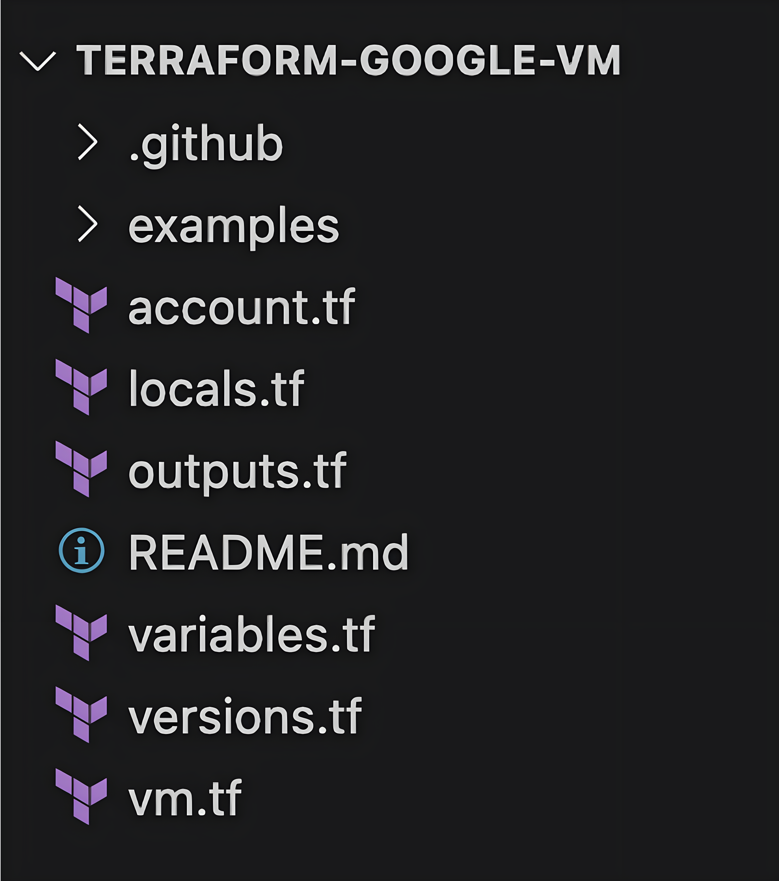
Module structure
Opinion: split resources into files
Sidenote: create usage examples

Slide 7
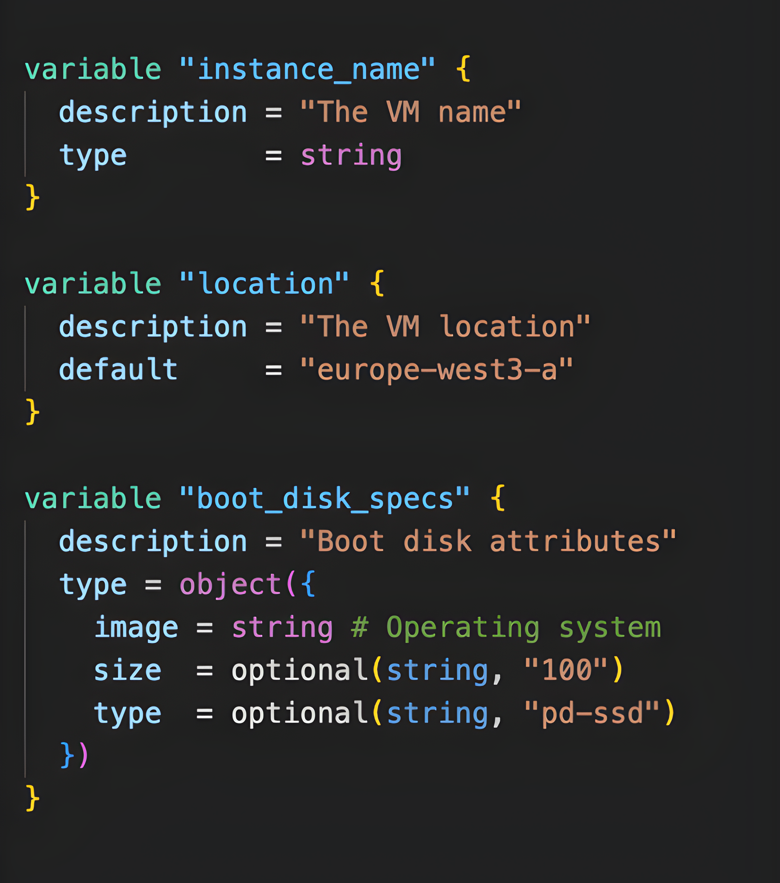
Code considerations
Defining inputs
Opinion: follow Terraform resource schemas
Local variables
Opinion: all in one locals.tf
Defining outputs
Opinion: output everything
Notes:
Input definition:
Complex inputs (objects) vs. simple inputs (e.g. strings only)
Example: google_container_cluster and google_container_node_pool => object input based on resource variables, common inputs (e.g. location) as separate simple string input instead of using it in the two object inputs
Explain null example (because funny)
If ”null” is used as default for optional variable
-> not treated as empty, it is treated as “variable/input is not present”
-> fallback to default value in resource schema of the provider
-> if no default there, it fallbacks to the default value of the underlying API (e.g. the cloud provider)

Slide 8

Versioning
Treat modules as a piece of software
Common: semantic versioning
Scenarios:
Input change
Output change
Resource changes
Provider upgrades

Slide 9
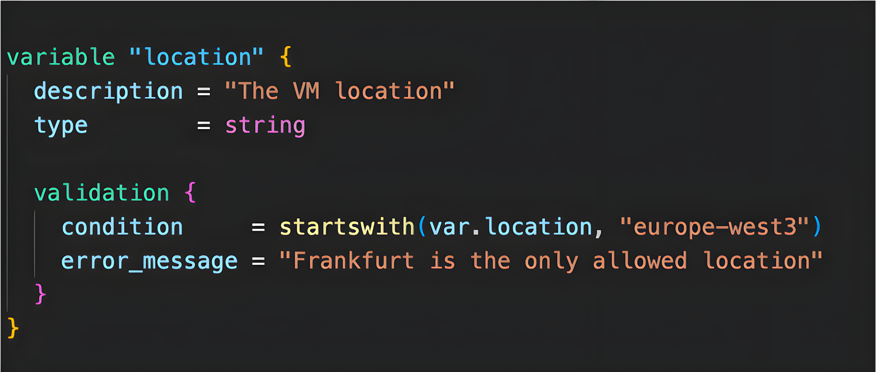
Security Considerations
Validation of submitted configuration
Validating input variables
Validation during terraform plan
In any case: validation before running the apply/rollout
Defining the level of configurability of the module
Notes:
Security considerations
- For the module itself as well as (1. bullet point)
– the infrastructure that’s set up with them (2. bullet point)
- OPA for OSS terraform
Hardcoding features/input variables

Slide 10




Module testing
Use the built-in terraform test framework
Implement into CI/CD setup (e.g., for pull request changes)
Don’t test each and every input scenario, focus on use-cases
Test module examples (examples directory)
Notes:
➔Built-in is better to use because no new framework or programming language needs to be embedded
Implement into CI/CD setup and implement E2E tests (so create real infrastructure and destroy afterwards)
Again: keep your company use cases in mind
If you provide module examples (which you should, your module users will appreciate them), test them as well

Slide 11

What else ?
Don’t hide your modules from development teams
improve contribution (issues, pull requests)
Improves acceptance of modules
Define decision records (ADRs) that reflect the module implementation

Slide 12

Final words
Every organization has its own requirements
Know when to not create a module
Module development is a process
start with an MVP
make use of standard software development principles
Notes:
Every organization has its own requirements
Those are of course reflected in the infrastructure and its deployment
Know then to not create a module
Don’t create modules that expose every input and output
Don’t force our users to use modules
When having security and compliance concerns, then work with organizational policies (GCP, AWS)
A module should provide a use case and an abstraction

Slide 13
THANK YOU !
Notes:
Possible extra points
Provider init in module
Provider constraints (Versions.tf) in module
Tflint / terraform fmt as part of CI/CD pipeline
Talking about outputs

